Slide 1
Areas of Cyber Security
(and the associated jobs)

Slide 2

Exercise: It All Starts w/ JTBD
What is JTBD?
Job to be Done.
Instead of looking at the solution level initially, first look at the real need that led to the creation of the solution.
A shift in perspective
Think from the perspective of those that are hiring:
What are their needs?
Where do you align with these needs?
What are the Jobs to be Done, in Security?
Consider what they may be…

Slide 3

Exercise Part Two:
Mapping yourself to specific JTBD’s
In your small groups, discuss a few of your experiences and how they may map to one of these specific needs.
How could this insight develop into a new career path?
Career Homework:
SWOT Analysis:
Strengths
Weaknesses
Opportunities
Threats
Look at the jobs you want, what they are looking for and identify gaps. Then, get to work on bridging those gaps.
This Photo by Unknown Author is licensed under CC BY-ND

Slide 4
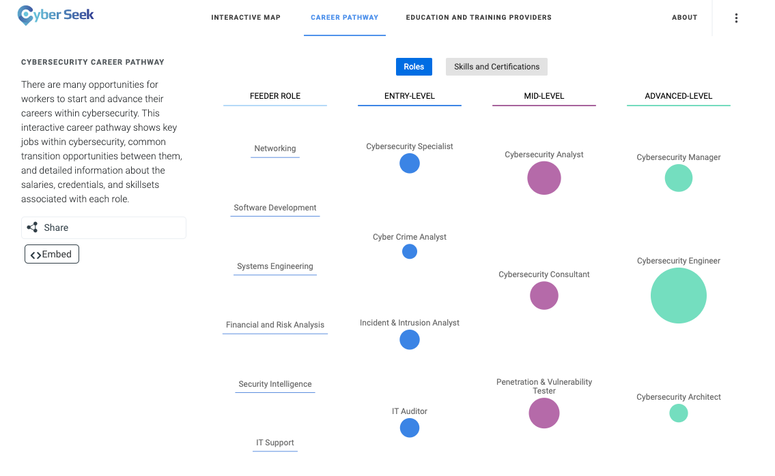

Key Resource
Cyber Seek
https://www.cyberseek.org/pathway.html

Slide 5
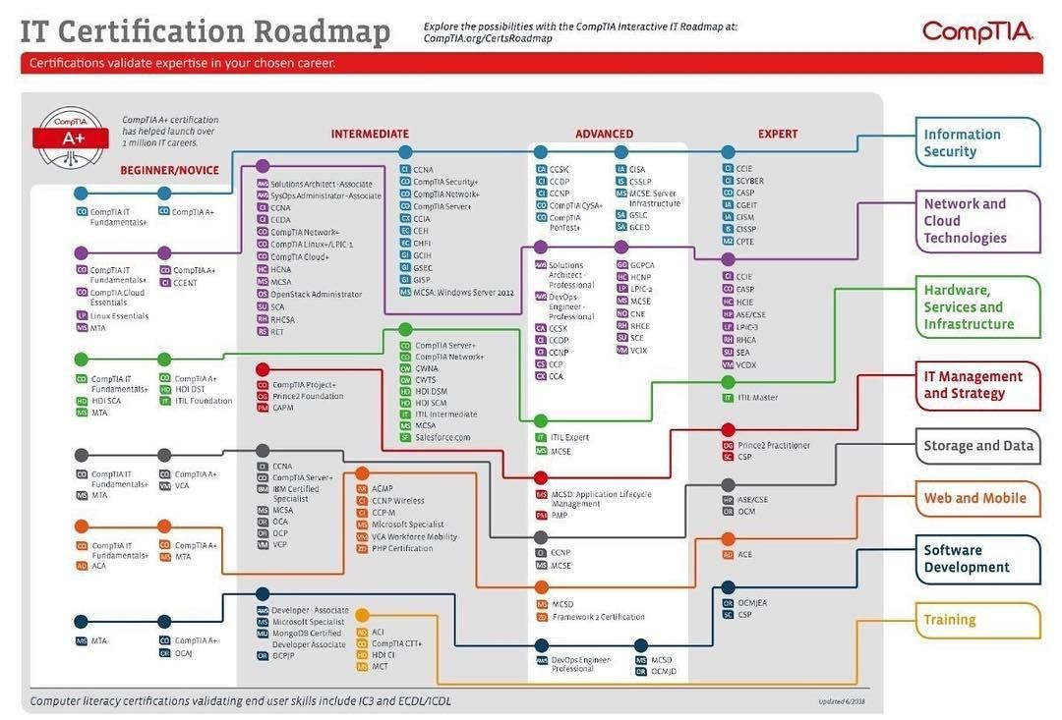
CompTIA Security Certification Roadmaps

Slide 6
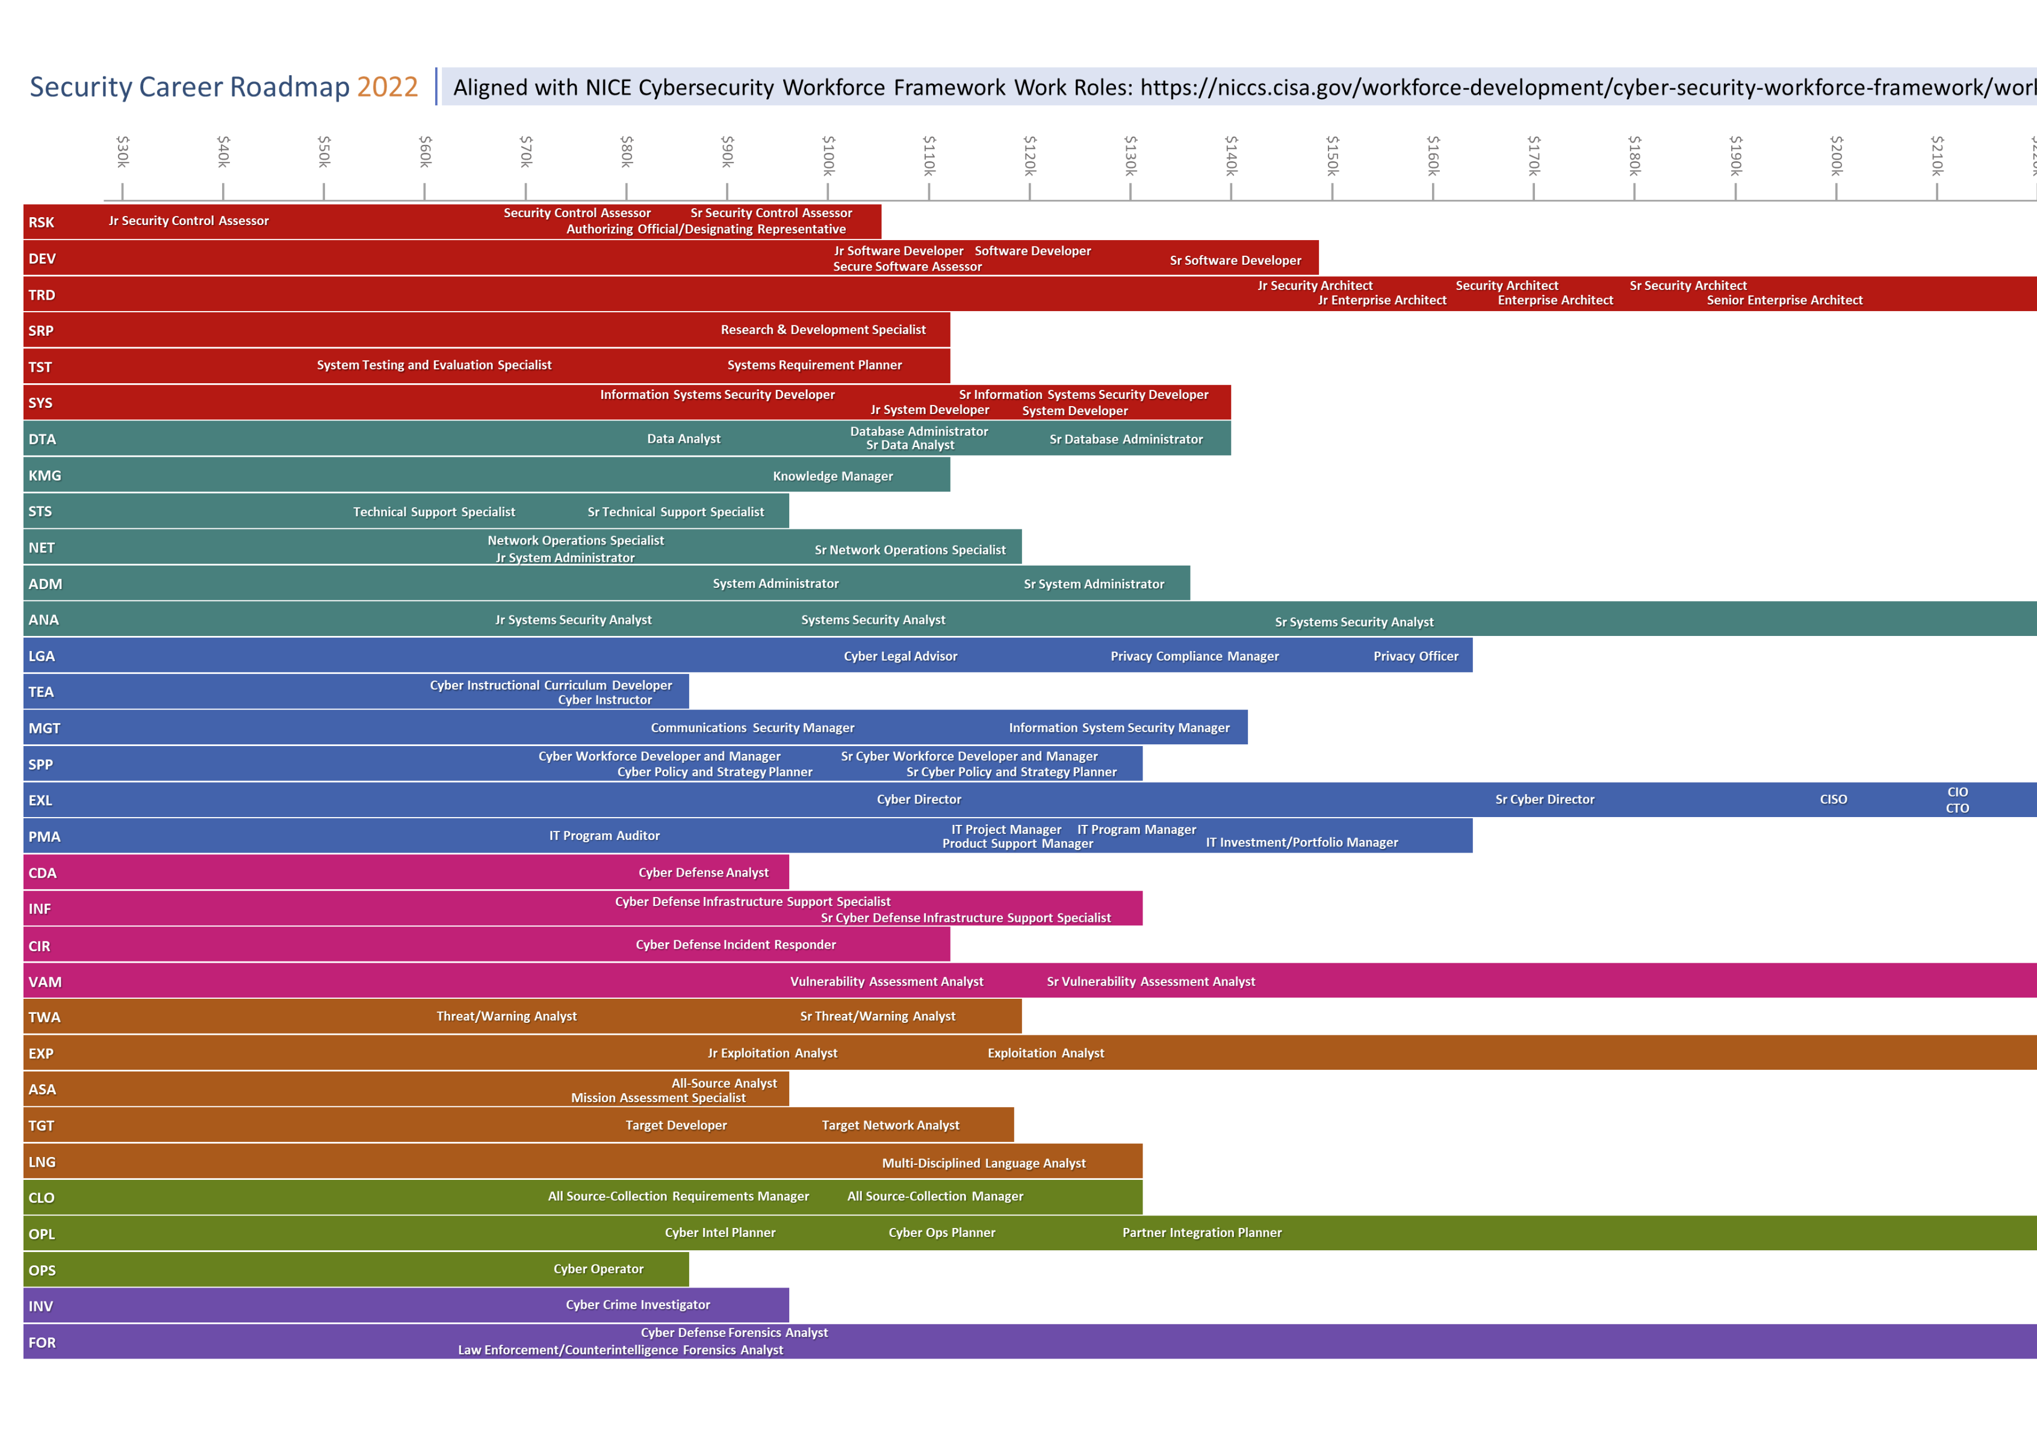
NICE Mapped IT Career Roadmap
Highly generalized
Industry/Sector Variance
Many jobs missing

